Slide 1
ITSC 200 – Network Protocols and Security
Linux

Slide 2
Today’s Objectives
Understand piping and redirection in Linux
Understand what environment variables are
Understand that Linux uses a “one command, one function” approach to commands
Use the “grep” command to find and isolate lines in a file
Use the “find” command in Linux
Create a small shell script

Slide 3
What is redirection ?
Sometimes we want the output of command to go somewhere else other than the screen. We can redirect the output of commands to do this.
It is often used to redirect command output to a file so the information can be stored or manipulated further.
We can also use redirection to provide input that a command would otherwise expect from the keyboard.

Slide 4
What is redirection ?
When we redirect output to a file, we can do it in two different ways :
If we use the “>” symbol to redirect output to a file, a new file with the output will be created every time we redirect … even if the file that we are redirecting to already exists.
If it does exist, the file is deleted and a new one created.
If we use the “>>” symbol to redirect output to a file, a new file with the output will be created if one does not exist, or the output will be appended to the end of the file if the file does exist.

Slide 5
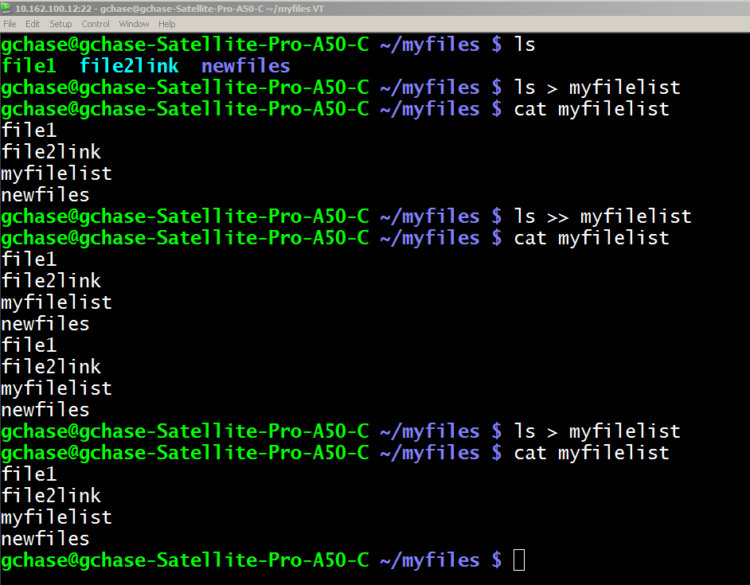
What is redirection ?

Slide 6
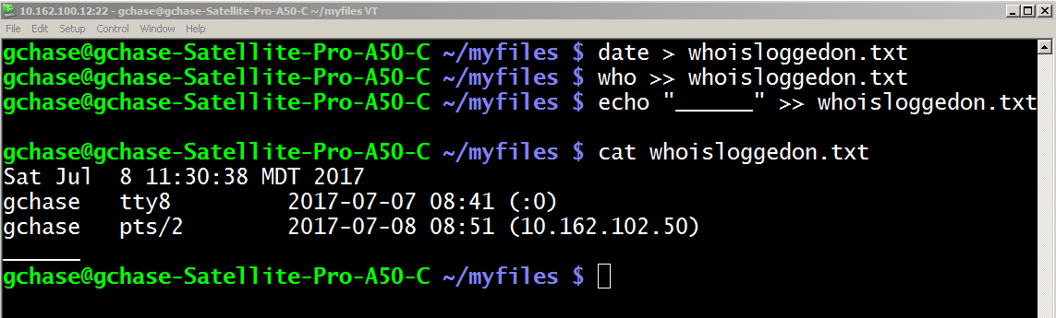
Redirection
We can use redirection for many things but it can become especially powerful when we use it with environment variables and in shell scripts.

Slide 7
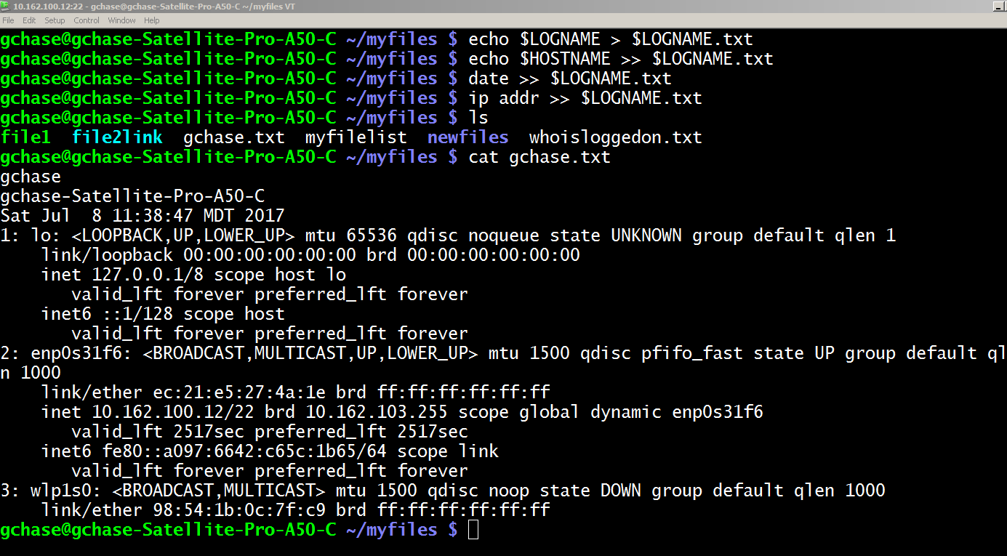
Redirection

Slide 8
Piping
Piping is similar to redirection but deals with the input and output of Linux commands.
In piping, the output of one command becomes the input of another command using the “|” symbol.
It is frequently used with the “grep” command which “finds” strings.
If I “cat” a large text file, I can “grep” for a particular word or string and isolate it in the output.

Slide 9
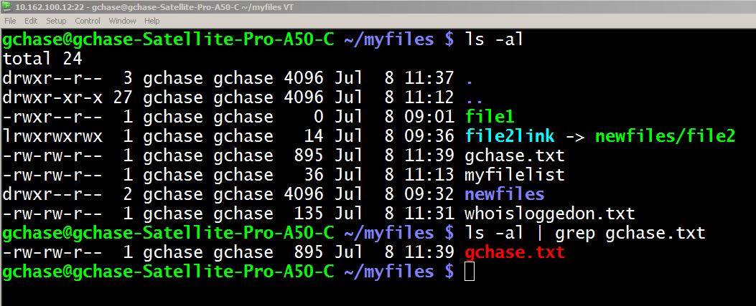
Piping

Slide 10
The UNIX Philosophy
Many small, specialized tools can be used as building blocks together to create very powerful commands.
A good example of this is the simple task of getting a list of all of the user accounts and their UID in alphabetical order from a Linux computer.
Of course you could download the /etc/password file onto your windows computer and bring it into Excel to manipulate … but in Linux it is a simple, one line command to do the same thing.

Slide 11
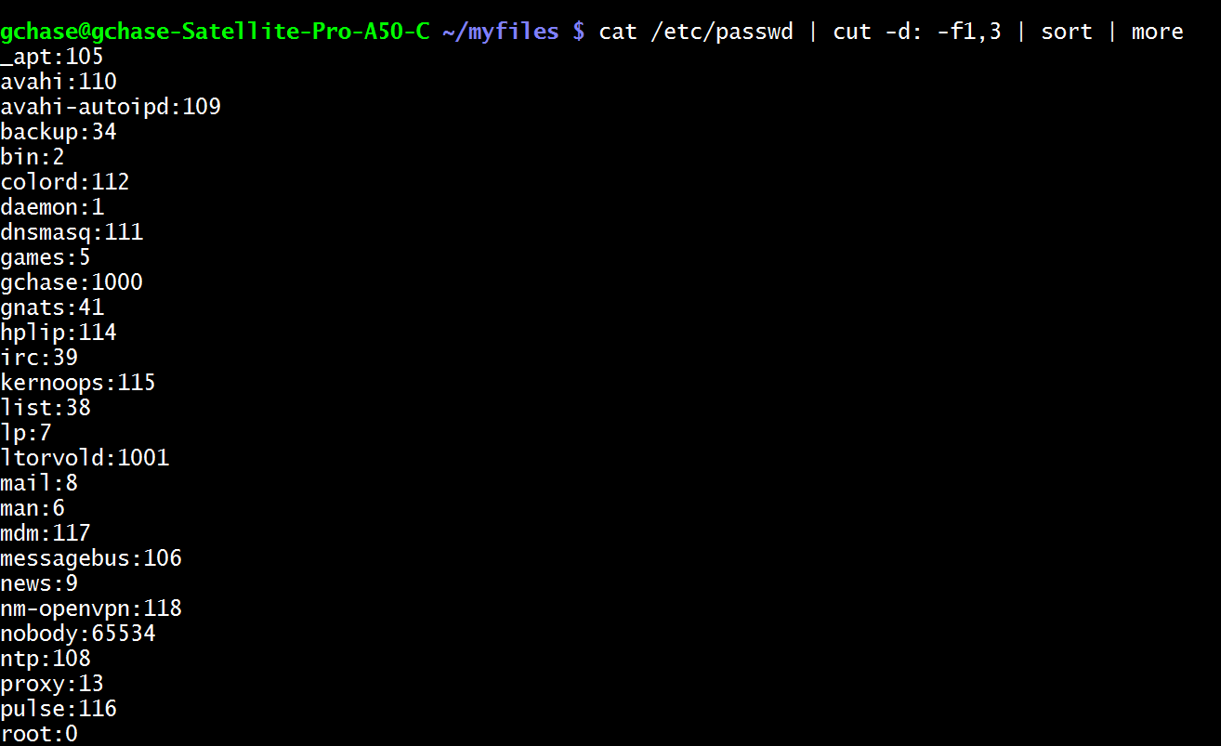
Finding Users and UID’s

Slide 12

Coffee Break!

Slide 13
Shell Scripts
Shell scripts are one of the most powerful aspects of working in Linux or UNIX. Many system administrators have dozens of scripts that they use in their day to day work.
Shell scripts are ordinary text files. There is nothing more than an editor needed to create them.
They always have as their first line a “shebang” which is “#!/usr/bin/env bash”
After the shebang, you can just enter Linux commands. One per line or using piping.

Slide 14
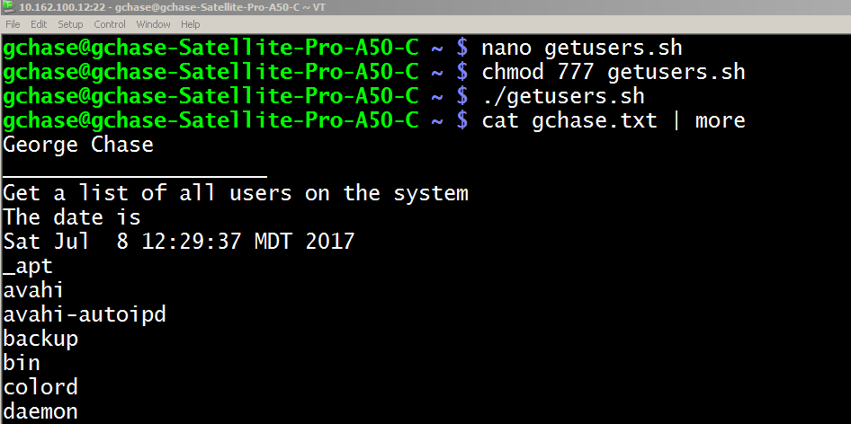
Shell Scripts
#!/usr/bin/env bash
cd /home/gchase
echo George Chase > $LOGNAME.txt
echo _____________________ >> $LOGNAME.txt
echo Get a list of all users on the system >> $LOGNAME.txt
echo The date is >> $LOGNAME.txt
date >> $LOGNAME.txt
cat /etc/passwd | cut -d: -f1 | sort >> $LOGNAME.txt

Slide 15
Shell Scripts
Note that we had to change the permissions of the script file in the previous screen so that it was executable.
Note, as well, that we need to precede the command to run the script with a “./” because the current directory is not part of our PATH environment variable
(PATH is used to tell the operating system where to look for executable files)
You could still run it even if it wasn’t executable by using the “bash” command first.

Slide 16
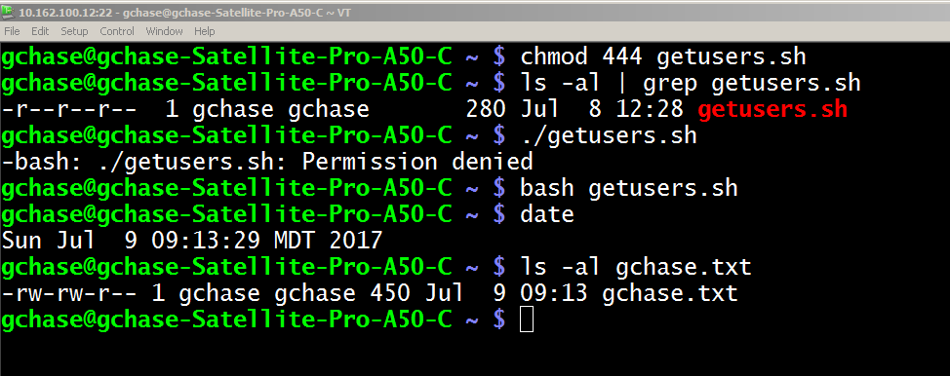
Shell Scripts

Slide 17
Finding Files
The “find” command is found in all Linux'es and UNIX'es.
“ find -name 'mypage.htm' “
Finds filename in current and subdirectories
“ find / -name 'mypage.htm' “
Finds filename anywhere from the root down
“ find / -size +500000 -print “
Finds files that are larger than 500MB anywhere from the root down

Slide 18
Creating a simple script
Download lab5.docx

Slide 19
Welcome to the ISS program!

